Slide 1
SAGAR INSTITUTE OF RESEARCH & TECHNOLOGY-EXCELLENCE Department of Computer Science & Engineering
Software Engineering
CS - 403

Slide 2
UNIT IV Software Analysis and Testing
Software Static and Dynamic analysis, Code inspections,
Software Testing Fundamentals , Software Test Process,
Testing Levels, Test Criteria, Test Case Design
Test Techniques, White -Box Testing
Black -Box Testing
Unit Testing Frameworks
Integration Testing, System Testing and other Specialized Testing
Test Plan, Test Metrics,
Introduction to Object-oriented analysis, design and comparison with structured software engineering.

Slide 3
Software Testing
LECTURE - 1
Software testing is an activity performed to Uncover Errors.
It is a critical element of software quality assurance and represents the ultimate review of specification design and coding.
The purpose testing is to ensure whether the software functions appear to be working according to specification and performance requirements.

Slide 4
Software Static and Dynamic analysis and testing
Static testing is software testing technique where testing is carried out without executing the code. This type of testing comes under Verification. ...
It has 2 parts as listed below:
Review - Typically used to find and eliminate errors or ambiguities in documents such as requirements, design, test cases, etc.
Static analysis - The code written by developers are analysed (usually by tools) for structural defects that may lead to defects.

Slide 5
Static analysis involves test and can detect possible defects in an early stage, before running the program.
Static analysis is done after coding and before executing unit tests.
Static analysis can be done by a machine to automatically “walk through” the source code and detect non complying rules. The classic example is a compiler which finds lexical, syntactic and even some semantic mistakes.
Quality attributes that can be the focus of static analysis:
Reliability
Maintainability
Testability
Re-usability
Portability
Efficiency

Slide 6
Dynamic testing and analysis is software testing technique where testing is carried out with executing the code. This type of testing comes under Validation.
Dynamic program analysis is performed with executing programs built from that software on a real or virtual processor.
Dynamic code analysis :
It identifies vulnerabilities in a runtime environment.
It allows for analysis of applications in which you do not have access to the actual code.
It permits you to validate static code analysis findings.
.

Slide 7
Code Inspection ( Review )
Code Inspection is the most formal type of review, which is a kind of static testing to avoid the defect multiplication at a later stage.
The main purpose of code inspection is to find defects
An inspection report lists the findings,
Preparation before the meeting is essential,
Inspections are often led by a trained moderator, who is not the author of the code.
The inspection process is the most formal type of review based on rules and checklists and makes use of entry and exit criteria.
It usually involves peer examination of the code and each one has a defined set of roles.
After meeting,a formal follow-up process is used to ensure that corrective action is completed in a timely manner.

Slide 8
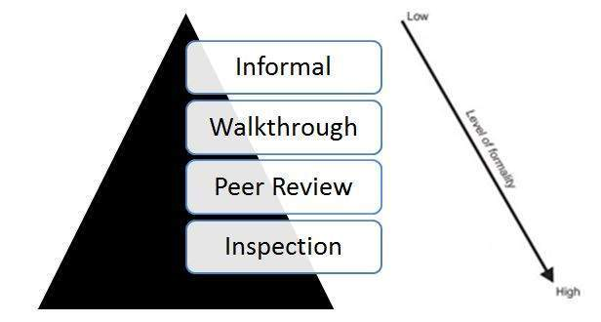
Types of Reviews:
The types of reviews can be given by a simple diagram:

Slide 9
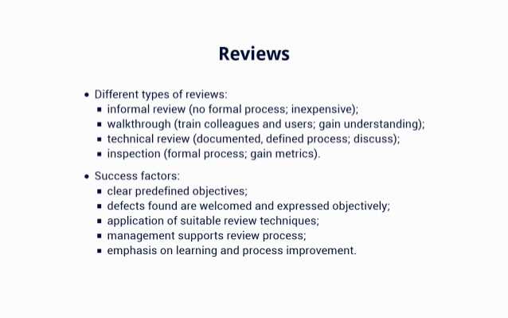

Slide 10
Formal Technical Review (FTR)
Objectives
To uncover errors in function, logic
To verify that the software under review meets its requirements
To ensure that the software has been represented according to predefined standards
To achieve software that is developed in a uniform manner
To make projects more manageable
Serves as a training ground for junior software engineers to observe different approaches to software analysis, design, and construction
Promotes backup and continuity
May sometimes be a sample-driven review

Slide 11
The FTR Meeting
Has the following constraints
From 3-5 people should be involved
Advance preparation
Focuses on a specific work product
Activities before the meeting
The producer informs the project manager that a work product is complete and ready for review, contacts a review leader, establishes an agenda.
Activities during the meeting
The meeting is attended by the review leader, all reviewers, the producer
After a brief introduction by the review leader, the producer proceeds to "walk through”
Activities at the conclusion of the meeting
All attendees must decide whether to
Accept the product without further modification
Reject the product due to severe errors (
Accept the product provisionally

Slide 12
FTR Guidelines
Review the product, not the producer
Set an agenda and maintain it
Limit debate
Enunciate problem areas, but don't attempt to solve the problem noted
Take written notes; utilize a wall board to capture comments
Limit the number of participants
Develop a checklist for each product in order to structure and focus the review
Allocate resources and schedule time for FTRs
Review your earlier reviews to improve the overall review process

Slide 13
Software Testing Fundamentals , Software Test Process,
LECTURE - 2
Characteristics of Testable Software
Operable
Observable
Controllable
Decomposable
Simple
Stable
Understandable

Slide 14
TESTING OBJECTIVES: 1. Testing is a process of executing a program with the intent of finding an error. 2. A good test case is one that has a high probability of finding an as yet undiscovered error. 3. Testing should systematically uncover different classes of errors in a minimum amount of time and with a minimum amount of effort.
TESTING PRINCIPLES:
All tests should be traceable to customer requirements.
Tests should be planned long before testing begins.
Testing should begin “in the small” and progress toward testing “in the large.”

Slide 15
TESTING PROCESS

Slide 16
Fundamental Test Process
Testing can be carried out in different phases and in each phase the verification is conducted by taking a review.
Various Testing activities are:-
Test planning
Test Case design
Test Execution
Data collection
Evaluation
Notes:
Important – learn these!
Testing is an activity performed in parallel with software development and one that consists of its own phases of planning, specifying, executing, recording and ongoing maintenance of tests.
We have to build or acquire tests before we can run them and careful planning and analysis of the test objectives and requirements must be done before we design and build tests. The timing emphasis is on getting most of the test planning and specification work completed before the software is designed and coded. The starting trigger to begin test specification and design is the availability of a specification for the software under test.
For example, the customer or the customer’s test agent should begin planning and specifying requirements-based acceptance tests as soon as the system’s requirements have been documented. As the system is being functionally designed at the high level the test team should begin planning and specifying design-based tests for execution during system testing. As the system is being internally designed at the low level the test team should begin planning and specifying design-based tests for execution during integration testing.
Test plans and objectives for each level of testing come first, then test design, then test implementation, and, finally, we can execute and evaluate.
Reference: William C. Hetzel, The Complete Guide to Software Testing, Collins, 1985, p 31, 39

Slide 17
LECTURE -3
Verification and Validation
Software testing is part of a broader group of activities called verification and validation that are involved in software quality assurance
Verification (Are the algorithms coded correctly?)
The set of activities that ensure that software correctly implements a specific function or algorithm
Validation (Does it meet user requirements?)
The set of activities that ensure that the software that has been built is traceable to customer requirements

Slide 18
Strategy for Testing Conventional Software
(Levels of testing)
A strategy for software testing integrates the design of software test cases into a well-planned series of steps that result in successful development of the software
The strategy provides a road map that describes the steps to be taken, when, and how much effort, time, and resources will be required
The strategy provides guidance and a set of milestones

Slide 19
Levels of Testing for Conventional Software
Unit testing
Integration testing-
Validation testing-
Provides final assurance that the software meets all functional, behavioral, and performance requirements
4.System testing –
The software and other system elements are tested as a whole. Verifies that all system elements (software, hardware, people, databases) mesh properly and that overall system function and performance is achieved

Slide 20
Levels of Testing
System Testing
Validation Testing
Integration Testing
Unit Testing
Narrow to
Broader scope
Code
Abstract to
concrete
Design
Requirements
System Engineering

Slide 21
1.Testing Techniques(for Unit Testing)
LECTURE - 4
White-box testing
Knowing the internal workings of a product, test that all internal operations are performed according to specifications
Logical paths through the software are tested
Test cases exercise specific sets of conditions and loops
Black-box testing
test to see if that function is fully operational and error free
Includes tests that are conducted at the software interface
Not concerned with internal logical structure of the software

Slide 22
White-box Testing
White Box Testing is a software testing method in which the internal structure/design/ implementation of the item being tested is known to the tester.
1.Basis Path Testing
Test cases derived to exercise the basis set are guaranteed to execute every statement in the program at least one time during testing

Slide 23
2. Deriving the Basis Set and Test Cases
Using the design or code as a foundation, draw a corresponding flow graph
Determine the cyclomatic complexity of the resultant flow graph
Determine a basis set of linearly independent paths
Prepare test cases that will force execution of each path in the basis set

Slide 24
Flow Graph Notation
A circle in a graph represents a node, which stands for a sequence of one or more procedural statements
A node containing a simple conditional expression is referred to as a predicate node and node has two edges leading out from it (True and False)
An edge, or a link, is a an arrow representing flow of control in a specific direction
An edge does not intersect or cross over another edge
Areas bounded by a set of edges and nodes are called regions
When counting regions, include the area outside the graph as a region, too

Slide 25
Flow Graph Example
FLOW CHART
FLOW GRAPH
0
0
R4
1
1
2
2
3
R3
3
6
4
6
4
R2
7
8
5
R1
7
8
5
9
9
11
11
10
10

Slide 26
Independent Program Paths
Defined as a path through the program from the start node until the end node that introduces at least one new set of processing statements or a new condition (i.e., new nodes)
Must move along at least one edge that has not been traversed before by a previous path
Basis set for flow graph on previous slide
Path 1: 0-1-11
Path 2: 0-1-2-3-4-5-10-1-11
Path 3: 0-1-2-3-6-8-9-10-1-11
Path 4: 0-1-2-3-6-7-9-10-1-11
The number of paths in the basis set is determined by the cyclomatic complexity

Slide 27
Cyclomatic Complexity
Cyclomatic complexity is a software metric, used to indicate the complexity of a program. It is a quantitative measure of the number of linearly independent paths through a program's source code.
Provides a quantitative measure of the logical complexity of a program
Defines the number of independent paths in the basis set
Can be computed three ways
The number of regions
V(G) = E – N + 2, where E is the number of edges and N is the number of nodes in graph G
V(G) = P + 1, where P is the number of predicate nodes in the flow graph G
Results in the following equations for the example flow graph
Number of regions = 4
V(G) = 14 edges – 12 nodes + 2 = 4
V(G) = 3 predicate nodes + 1 = 4

Slide 28
A Second Flow Graph Example
1 int functionY(void)
2 {
3 int x = 0;
4 int y = 19;
5 A: x++;
6 if (x > 999)
7 goto D;
8 if (x % 11 == 0)
9 goto B;
10 else goto A;
11 B: if (x % y == 0)
12 goto C;
13 else goto A;
14 C: printf("%d\n", x);
15 goto A;
16 D: printf("End of list\n");
17 return 0;
18 } 17-15
3
4
5
6
8
7
10
9
16
11
17
13
12
14
15

Slide 29
3. TESTING OF LOOP a)Testing of Simple Loops
Skip the loop entirely
Only one pass through the loop
Two passes through the loop
m passes through the loop, where m < n
n –1, n, n + 1 passes through the loop
b)Testing of Nested Loops
Start at the innermost loop; set all other loops to minimum values
Continue until all loops have been tested

Slide 30
c) Testing of Concatenated Loops
d) Testing of Unstructured Loops

Slide 31
Black-box Testing
LECTURE - 5
BLACK BOX TESTING, also known as Behavioral Testing, Black Box Testing is a software testing method in which the internal structure/ design/ implementation of the item being tested is NOT known to the tester.
Focuses on the functional requirements and the information domain of the software
Used during the later stages of testing after white box testing has been performed
Black-box Testing Categories
Incorrect or missing functions
Interface errors
Errors in data structures or external data base access
Behavior or performance errors
Initialization and termination errors

Slide 32
Equivalence Partitioning
A black-box testing method that divides the input domain of a program into classes of data from which test cases are derived
An equivalence class represents a set of valid or invalid states for input conditions

Slide 33
Guidelines for Defining Equivalence Classes
If an input condition specifies a range, one valid and two invalid equivalence classes are defined
Input range: 1 – 10 Eq classes: {1..10}, {x < 1}, {x > 10}
If an input condition requires a specific value, one valid and two invalid equivalence classes are defined
Input value: 250 Eq classes: {250}, {x < 250}, {x > 250}
If an input condition specifies a member of a set, one valid and one invalid equivalence class are defined
Input set: {-2.5, 7.3, 8.4}
Eq classes: {-2.5, 7.3, 8.4}, {any other x}
If an input condition is a Boolean value, one valid and one invalid class are define
Input: {true condition}
Eq classes: {true condition}, {false condition}

Slide 34
Boundary Value Analysis
A greater number of errors occur at the boundaries of the input domain rather than in the "center"
Boundary value analysis complements equivalence partitioning
It selects test cases at the edges of a class
It derives test cases from both the input domain and output domain

Slide 35
LECTURE - 7
Unit Testing Frame Work
Module interface-
Ensure that information flows properly into and out of the module
Local data structures
Ensure that data stored temporarily maintains its integrity
Boundary conditions
Ensure that the module operates properly at boundary values
Independent paths (basis paths)
all statements in a module have been executed at least once
Error handling paths
Ensure that algos respond correctly to specific error conditions

Slide 36
LECTURE - 8
2. Integration Testing
Focuses on the design and construction of the software architecture . Focuses on inputs and outputs, and how well the components fit together and work together.
Two Approaches
Non-incremental Integration Testing
Incremental Integration Testing
Non-incremental Integration Testing
Commonly called the “Big Bang” approach
All components are combined in advance
The entire program is tested as a whole
Correction is difficult because isolation of causes is complicated

Slide 37
Incremental Integration Testing
Top-down integration
Bottom-up integration
Sandwich integration
The program is constructed and tested in small increments

Slide 38
Top-down Integration
Modules are integrated by moving downward through the control hierarchy, beginning with the main module
Subordinate modules are DF and BF
DF: All modules on a major control path are integrated
BF: All modules directly subordinate at each level are integrated

Slide 39
Bottom-up Integration
Integration & testing starts with the most atomic modules in the control hierarchy
Sandwich Integration
Consists of a combination of both top-down and bottom-up integration
Occurs both at the highest level modules and also at the lowest level modules

Slide 40
Regression Testing
Each new addition or change to baselined software may cause problems with functions that previously worked flawlessly
Regression test suite contains three different classes of test cases
A sample of tests that will exercise all software func
Additional tests that focus on that are likely to be affected by the change
Tests that focus on the actual SW components that have been changed

Slide 41
Smoke Testing
Power is applied and a technician checks for sparks, smoke, or other dramatic signs of fundamental failure Includes the following activities
The software is compiled and linked into a build
A series of breadth tests is designed to expose errors
The build is integrated with other builds and the entire product is smoke tested daily.
After a smoke test is completed, detailed test scripts are executed
Benefits of Smoke Testing
Integration risk is minimized
uncover both functional errors and architectural and component-level design errors

Slide 42
3.Validation Testing
Validation testing follows integration testing
Demonstrates conformity with requirements
Designed to ensure that
All functional requirements are satisfied
All behavioral characteristics are achieved
All performance requirements are attained
Documentation is correct
Usability and other requirements are met (e.g., transportability, compatibility, error recovery, maintainability)
After each validation test
The function or performance characteristic conforms to specification and is accepted
A deviation from specification is uncovered and a deficiency list is created
A configuration review or audit ensures that all elements of the software configuration have been properly developed

Slide 43
Alpha and Beta Testing
Alpha testing
Conducted at the developer’s site by end users
Software is used in a natural setting with developers watching intently
Testing is conducted in a controlled environment
Beta testing
Conducted at end-user sites
Developer is generally not present
The end-user records all problems that are encountered and reports these to the developers at regular intervals
After beta testing is complete, software engineers make software modifications and prepare for release of the software product .

Slide 44
4. System Testing
1.Recovery testing
Tests for recovery from system faults
Tests reinitialization, check pointing mechanisms, data recovery, and restart for correctness
2 Security testing
Verifies that protection mechanisms built into a system will, in fact, protect it from improper access
3.Stress testing
Executes a system in a manner that demands resources in abnormal quantity, frequency, or volume
4.Performance testing
Tests the run-time performance of software
Often coupled with stress testing and usually requires both hardware and software instrumentation

Slide 45
Test Strategies for Object-Oriented Software
Test "in the small" and then work out to testing "in the large"
Testing in the small involves class attributes and operations
Testing in the large involves a series of regression tests to uncover errors due to communication and collaboration among classes
Class testing for object-oriented software is the equivalent of unit testing focuses on operations encapsulated by the class and the state behavior of the class

Slide 46
Two different object-oriented testing strategies
Thread-based testing
Integrates the set of classes required to respond to one input or event for the system
Each thread is integrated and tested individually
Use-based testing- First tests independent classes like server classes.
Then the next layer of classes, called dependent classes, are integrated
This sequence of testing layer of Independent classes continues until the entire system is constructed

Slide 47
LECTURE - 9
TEST PLAN Fundamentals
A Software Test Plan is a document describing the testing scope and activities.
master test plan : A test plan that typically addresses multiple test levels.
phase test plan : A test plan that typically addresses one test phase.
Testing Level Specific Test Plans : Plans for each level of testing.
Unit Test Plan
Integration Test Plan
System Test Plan
Acceptance Test Plan

Slide 48
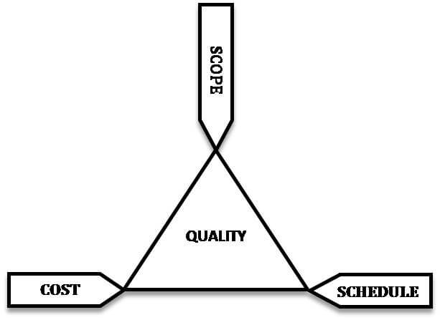
Software Testing Metric
In software testing, Metric is a quantitative measure of the degree to which a system, system component, or process possesses a given attribute.
.
"Software testing metrics - Improves the efficiency and effectiveness of a software testing process."

Slide 49
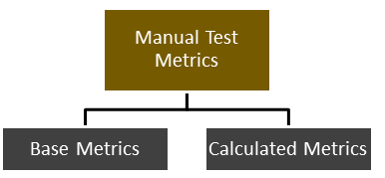
Manual Test Metrics - into two classes
Base Metrics
Calculated Metrics
Base metrics is the raw data collected by Test Analyst during
Calculated metrics is derived from the data collected in base metrics. Calculated metrics is usually followed by the test manager for test reporting purpose ( % Complete, % Test Cover age ). .

Slide 50
Test Metrics Life Cycle
Different stages of Metrics life cycle | Steps during each stage
Analysis | Identification of the Metrics Define the identified Metrics
Communicate | Explain the need for metric to stakeholder and testing team Educate the testing team about the data points need to be captured for processing the metric
Evaluation | Capture and verify the data Calculating the metrics value using the data captured
Sr# | Steps to test metrics | Example
1 | Identify the key software testing processes to be measured | Testing progress tracking process
2 | In this Step, the tester uses the data as baseline to define the metrics | The number of test cases planned to be executed per day
3 | Determination of the information to be followed, frequency of tracking and the person responsible | The actual test execution per day will be captured by the test manager at the end of the day
4 | Effective calculation, management and interpretation of the defined metrics | The actual test cases executed per day
5 | Identify the areas of improvement depending on the interpretation of defined metrics | The Test Case execution falls below the goal set, we need to investigate the reason and suggest the improvement measures

Slide 51
Report | Develop the report with effective conclusion Distribute report to the stakeholder and respective representative Take feedback from stakeholder

Slide 52
How to calculate test metric
To obtain the execution status of the test cases in percentage, we use the formula.
Percentage test cases executed
= (No of test cases executed / Total no of test cases written) x 100

